Slide 1
Codebasics
Market Fit Research using AQI Analytics
DOMAIN: CONSUMER APPLIANCES
FUNCTION: MARKET RESEARCH ANALYTICS

Slide 2
About
A BEGINNER’S INTRODUCTION
We all know about the air quality crisis in india with 14 cities ranking among the world’s top 20 most polluted urban centers.
As an emerging startup, AirPure Innovations is in the early phases of designing air purifiers tailored to the needs of residents in heavily polluted cities across India.

Slide 3
Three dimensions of the analysis
HEALTH IMPACT CORRELATION
SEVERITY MAPPING
DEMAND TRIGGERS
AQI levels across India are observed and high-risk areas are spotted. Compared pollution intensity and pollution trends were highlighted.
It shows that air pollution and poor environmental conditions are associated with high disease prevalence in several Indian states
Demand for air purifiers is analyzed across India. It shows that there’s a disconnect between pollution levels and consumer demand signals

Slide 4
Severity Mapping
PRIMARY ANALYSIS
Top 5 and bottom 5 areas according to average AQI.
AQI on weekends vs weekdays in Indian metro cities.
States showing consistent worst air quality.
Bengaluru AQI status from March 2025 - May 2025.
Months with highest Average AQI

Slide 5
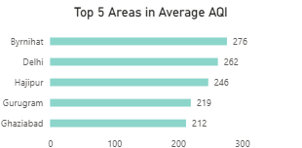
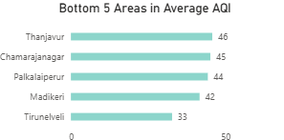
Top 5 and Bottom 5 areas according to average AQI.
Top 5 areas - Byrnihat, Delhi, Hajipur, Gurugram, Ghaziabad
Bottom 5 areas - Thanjavur, Chamarajanagar, Palkalaiperur, Madikeri, Thirunalveli

Slide 6
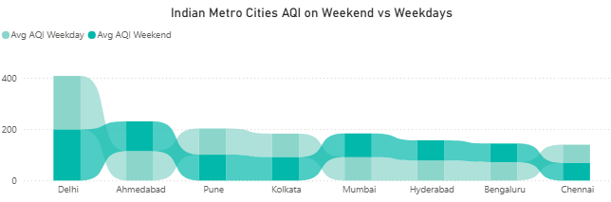
AQI weekend vs weekdays in Indian metro cities
AQI is higher on weekends in cities with a strong IT presence. This may be due to increased personal vehicle use and outdoor activities during weekends.

Slide 7
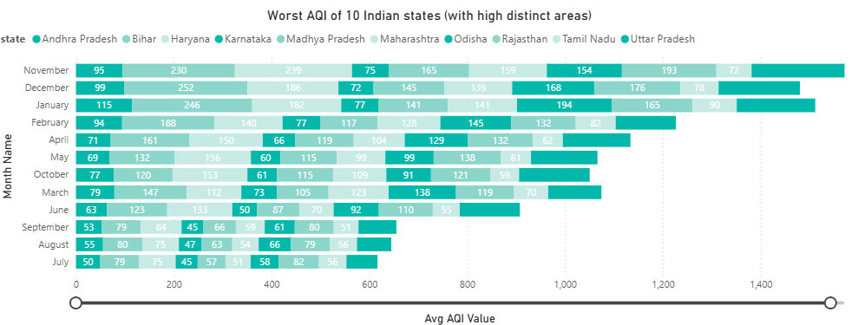
States showing consistent worst air quality
Andhra Pradesh, Bihar, Haryana, Karnataka, MP, Maharashtra, Odisha, Rajasthan, Tamil Nadu, Uttar Pradesh.

Slide 8
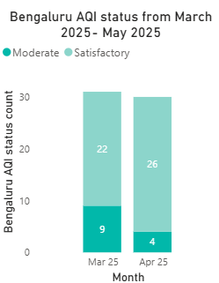
Bengaluru AQI status from March 2025 - May 2025
Bengaluru has mostly ‘Satisfactory’ status across the two months.

Slide 9
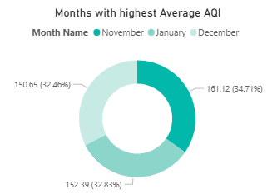
Months with highest Average AQI
November, January and December are observed to be the months with highest AQI.

Slide 10
Severity Mapping
SECONDARY ANALYSIS
Relationship between AQI and Population of each state.
City Risk Scores for Tier - 1 and Tier - 2 cities.
Tier - 1 and Tier - 2 cities with irreversible AQI degradation.
AQI status distribution.

Slide 11
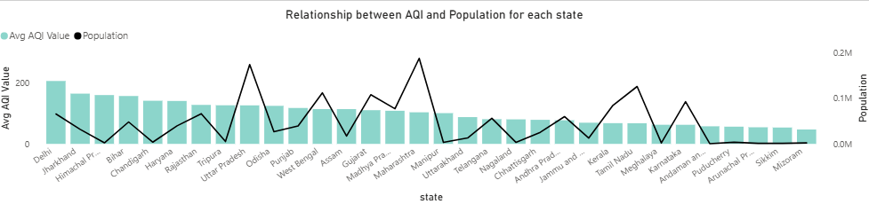
Relationship between AQI and population
No strong linear correlation is observed between population and AQI across states.
AQI levels are influenced more by urbanization, industrialization, and vehicle density than just population size.

Slide 12
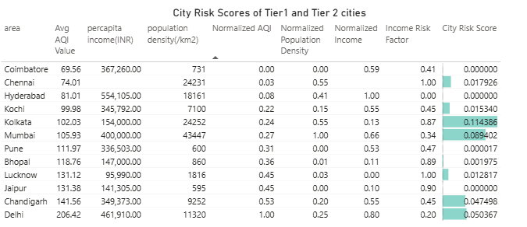
City Risk Scores of Tier -1 and Tier - 2 cities
Kolkata, Mumbai and Delhi have high City Risk Scores.

Slide 13
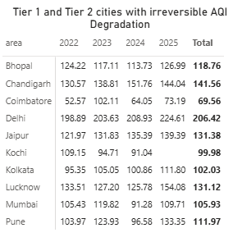
Tier -1 and Tier - 2 cities with irreversible AQI degradation
Cities such as Delhi, Chandigarh, and Jaipur are experiencing critical long-term AQI deterioration, with no signs of reversal, underlining the urgent need for policy intervention and pollution control measures

Slide 14
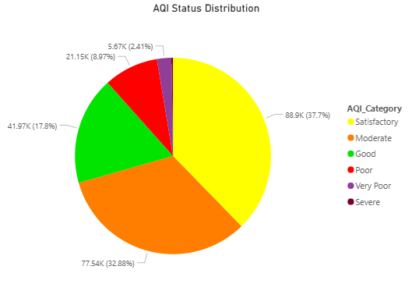
AQI Status distribution
Over 70% of regions fall within satisfactory to moderate AQI, but a worrying 13% fall under poor to severe, underscoring the need for localized interventions to prevent further degradation.

Slide 15
Health Impact Correlation
Top 2 and bottom 2 prominent pollutants for each state of southern India.
Top 2 most reported disease illnesses in each state over the past 3 years.
Top 5 states with high EV adoption and their AQI analysis.

Slide 16
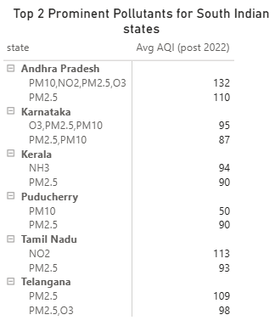
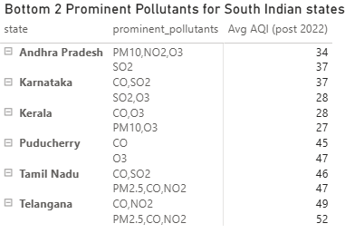
Top 2 and Bottom 2 pollutants in south indian states

Slide 17
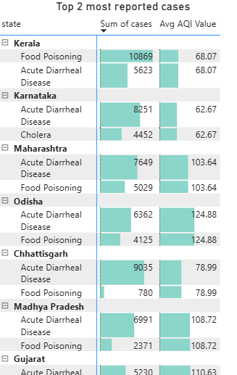
Top 2 most reported disease illnesses in each state over the past 3 years.
Acute Diarrheal disease, Food Poisoning and Dengue are the amongst the top reported diseases.
Kerala, Karnataka and Maharashtra has most reported cases.

Slide 18
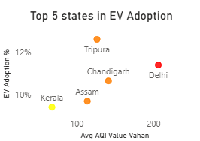
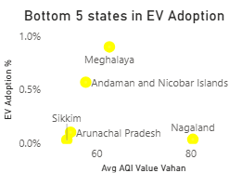
Top 5 states with high EV adoption and their AQI analysis.
Top 5 states - Tripura, Delhi, Chandigarh, Assam, Kerala
Bottom 5 states - Meghalaya, Andaman & Nicobar Islands, Arunachal Pradesh, Nagaland, Sikkim

Slide 19
Demand Triggers
Trends in interest over months.
Pollution spikes and shifts in customer behavior.

Slide 20
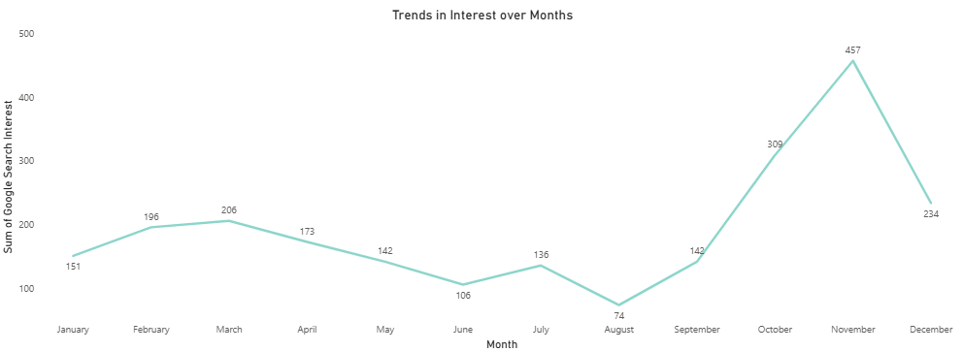
Source:
Google Trends
Trends in Interest over months
High Interest in late year is observed and mid-year indicated the low interest.

Slide 21
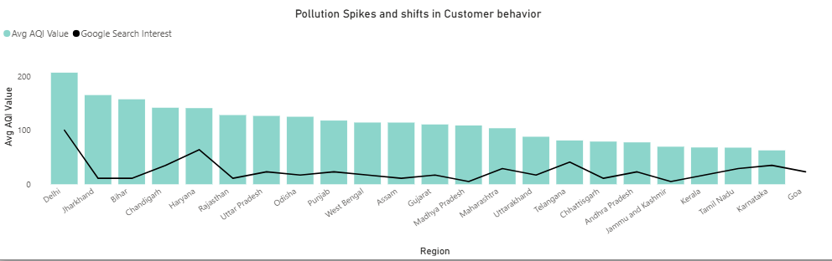
Source:
Google Trends
Pollution spikes and shifts in customer behavior
Delhi stand out with the highest AQI and relatively high search interest.

Slide 22
Source:
Flipkart
Air Purifiers in current market
Brand | Model Name | Price (INR) | Filter Types | Coverage Area (sq ft) | Noise Level (dB) | Smart Features | Warranty | Air Flow Level(cu.m/hr) | Power Consumption(W) | Weight(kg)
Dyson | Pure Cool Link | 39,899 | HEPA | 450 | NA | Portable, App | 2 years | 915 | 58 | 3.7
Dyson | Hot + Cool | 59,900 | HEPA | 600 | NA | Portable, App | 2 years | 1044 | 40 | 5.7
Philips | AC4372/10 | 40,499 | HEPA, Activated Carbon | 753 | 38 | AQI Display | 2 years | 341 | 50 | 7.45
Phillips | AC 1711/63 | 11,880 | HEPA | 380 | 50 | Portable,AQI Display | NA | 300 | 50 | 3.78
Phillips | AC2887 | 2,500 | HEPA | 200 | 50 | Portable,AQI Display | NA | 3.6 | 0 | 0.5
Mi | AC-M16-SC | 13,999 | HEPA | 516 | 32.1 | App, Alexa, Google | 1 year | 400 | 30 | 5.6
Mi | AC-M17-SC | 9,999 | HEPA | 463 | NA | Wifi, AQI Indicator | NA | 360 | 33 | 4.8
Coway | AirMega Aim | 12,999 | Pre-Filter, Activated Carbon, HEPA | 303 | NA | Filter Change Indicator | NA | 353 | 38 | 4.9
Honeywell | HAC30M1301G | 11,999 | HEPA | 387 | 18 | Wifi, AQI Indicator | 1 year | 300 | 42 | 6.5
Honeywell | Air Touch V5 | 9,710 | HEPA, Activated Carbon | 589 | NA | Wifi, AQI Indicator | 2 years | 2 | 35 | 3.5
Sharp | FX-S120M-H | 43,140 | HEPA, Activated Carbon | 930 | 55 | Wifi, AQI Indicator | 1 year | 702 | 72 | 10
Sharp | FP-F40E-T | 11,390 | HEPA, Activated Carbon | 320 | 55 | Portable,Plasmacluster | 1 year | 240 | 31 | 4.7

Slide 23
Insights
These air purifiers are considered to be the top performers for the below reasons:
Mi AC-M16-SC – Best value; smart features, efficient airflow, mid-range price
Dyson Hot + Cool – Premium build, highest airflow, energy efficient
Sharp FX-S120M-H – Ideal for large spaces, smart features, high capacity

Slide 24
Wishlist for a competitive Air Purifier
Smart Efficiency Optimization
Full-Suite Smart Connectivity
Ultra Quiet Design (<30 dB in Sleep Mode)
Modular, Easy-to-Replace Filters
Predictive Maintenance & Self-Diagnostics
Coverage-Aware Design
Portability & Aesthetics
Competitive Pricing Range: ₹10,000–₹15,000
Eco-Friendly Packaging & Build

Slide 25
Q & A
Q. What pollutants or particles should their air purifier target?
A. Based on air quality data across Indian cities, The air purifier should prioritize PM2.5 and PM10 filtration, followed by gases like NO₂ and SO₂, particularly in metro and industrial regions.
Q. Which cities have the highest demand for air purifiers & what is the market size?
A. High AQI Metro Cities: Delhi, Ghaziabad, Pune, Mumbai, Kolkata, Ahmedabad. These cities frequently exceed AQI > 100, often crossing 200–300 in winter.

Slide 26
Q & A
Q. How can R&D align with localized pollution patterns?
A. Location-Based Customization:
- North India (Delhi, UP, Punjab): High PM2.5 in winter. R&D focus on filters that can handle crop-burning pollution and dense fog particles.
- Western India (Ahmedabad, Mumbai): Industrial & vehicular pollution. Carbon and gas filters emphasized.
- South India (Bengaluru, Chennai): Lower AQI but rising focus on compact smart models for tech-savvy, indoor users.

Slide 27
Final Takeaways
Demand Indicators:
Affluent population + High AQI = High potential
Hospitals, hotels, co-working spaces, schools are early adopters
Agile R&D Strategy:
City-segmented feedback loops from pilot customers.
Partner with health institutions and local governments for data-sharing.
Use Power BI dashboards to continuously monitor evolving pollution patterns and guide product iterations.

Slide 28
Thank You

